Slide 1

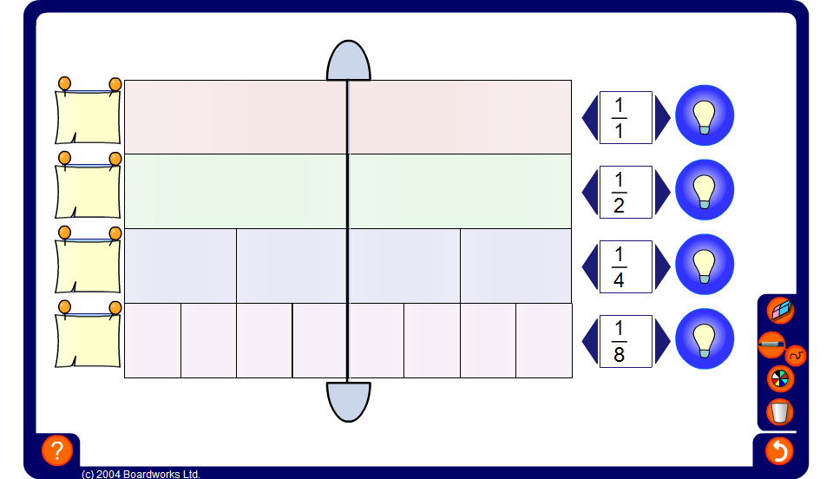


Equivalent fractions
Notes:
Start by showing two bars.
Set one bar to show ¹/₈s and the other to show ¹/₄s.
Ask a volunteer to shade in half of the bar showing ¹/₈s.
How many ¹/₈s make ¹/₂? (4)
⁴/₈ is the same as one half.
How many sixths make one half? (3)
³/₆ is also the same as one half.
Show this amount on the bar.
Turn on another bar. Set it to show fifths.
Can any number of fifths make a half?
Now set the bar to show sevenths.
What about sevenths?
Establish that to make a fraction the same as a half the bar must be divided into an even number of equal pieces.
Ask pupils to state any other fractions they can think of equal to a half.
Turn on all four bars and ask pupils to show their suggestions on the board.
Repeat the exercise for ²/₃. Start by setting two of the bars to thirds and sixths. Ask a volunteer to shade in two thirds of the bar showing thirds and continue as before.
Establish that to show a fraction equal to ²/₃ the bar must be divided into a number of parts equal to a multiple of three.
Ask pupils what they notice about the numerator (the top number) for all fractions equal to ²/₃.
The numerator is always a multiple of 2 (an even number) and the denominator is always a multiple of 3.
Repeat the exercise for ¾.
Establish that, in this case, the denominator is always a multiple of 4 and the numerator is always a multiple of 3.
Pupils should notice that the numerator and the denominator are multiplied by the same number. Ask a volunteer to justify this using the fraction bars.

